Slide 1
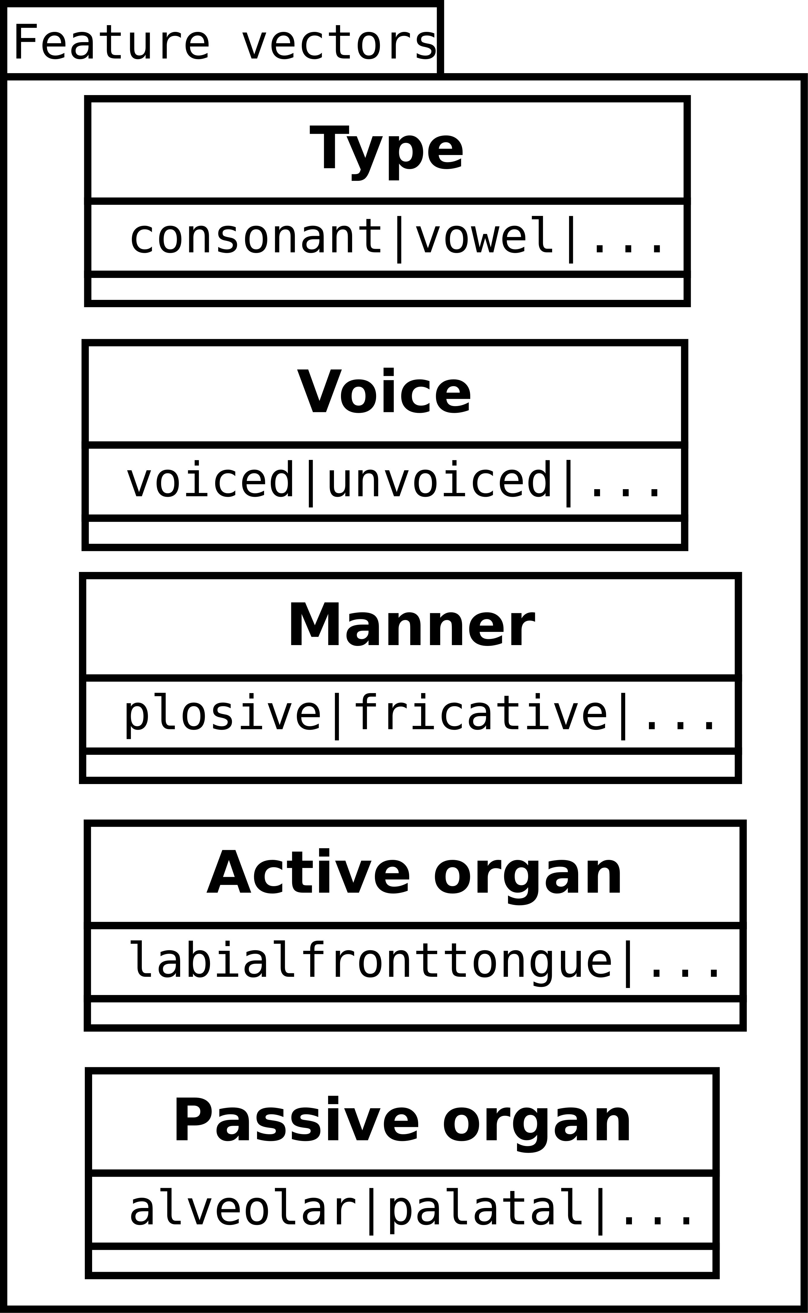
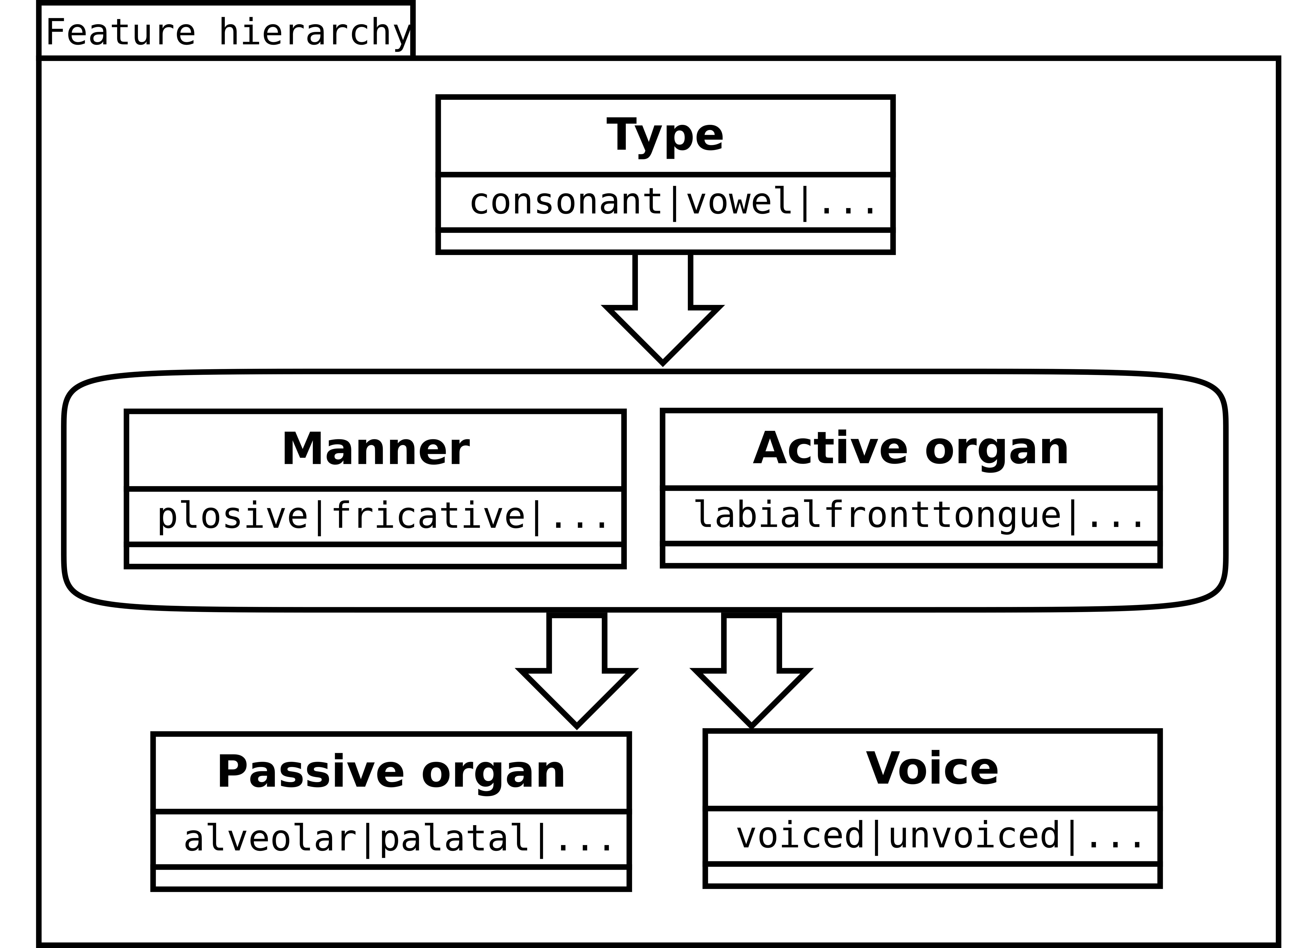
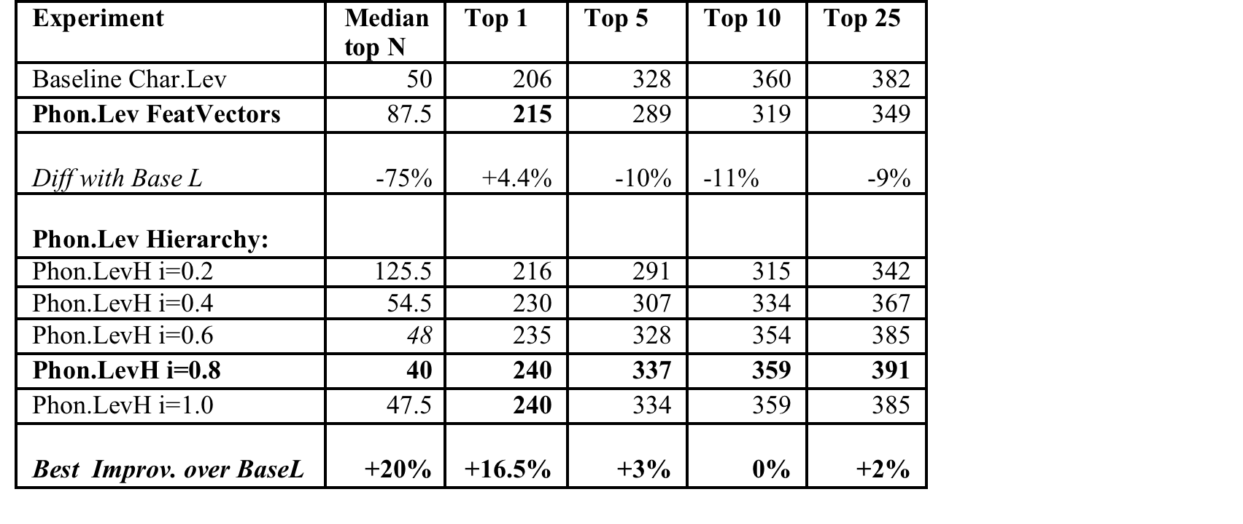
Development and evaluation of phonological models
for cognate identification
Bogdan BABYCH
Centre for Translation Studies, University of Leeds, UK
b.babych@leeds.ac.uk
Approach
Problems and solutions
Cognate identification important for MT & CAT
Building cognate term-banks from comparable corpora;
Lexicon for closely-related & under-resourced languages;
Additional data source for statistical sentence alignment, etc…
Current methods rely on character-based distances (e.g., Levenshtein)
Count insertions, deletions, substitutions of characters
Treat each character as an ‘atomic’ unit without structure
Difficult to apply across different scripts (need transliteration)
Solution: phonological features of characters to calculate similarity
Characters mapped to sets of distinctive acoustic features
Used in historical linguistics and dialectological studies
Applied to cognate identification for MT (cf. Babych, 2016)
Large-vocabulary cognate identification ≠ historic linguistic studies
False positives due to many more plausible alternatives
In pilot: phonological feature vectors degraded performance
Baseline character-based Levenshtein more resistant to errors
Some errors of Phonological Levenshtein metric due to imbalanced cost of insertion/deletion vs. substitution, e.g., for 5 phonological features:
Typical substitution cost for unrelated consonants = 0.8
Insertion/deletion cost = 1.0 leads to under-generation of cognates with inserted / deleted character
We need a systematic way for development and evaluation of alternative feature models, arrangements and operation costs
(a framework for phonological feature engineering).
vs.
…etc.
Development and evaluation framework for phonological models
Evaluation results
Conclusions
Hierarchical phonological models improve accuracy of large-vocabulary cognate identification up to 20% on Top-N measures.
Evaluation and development framework for phonological models
Allows for accurate feature calibration and parameter setting
Enables a systematic task-based feature engineering.
Potential applications beyond cognate identification:
Interlingual Transliteration via common phonological space;
Character-based models for Neural MT;
Morphology induction & morphological variation modelling.
Future work: evaluating alternative feature topologies, integrating statistical and semantic filters for cognate identification
Phonological models and resources (feature sets + scripts)released on https://github.com/bogdanbabych/cognates-phonology

